Slide 1
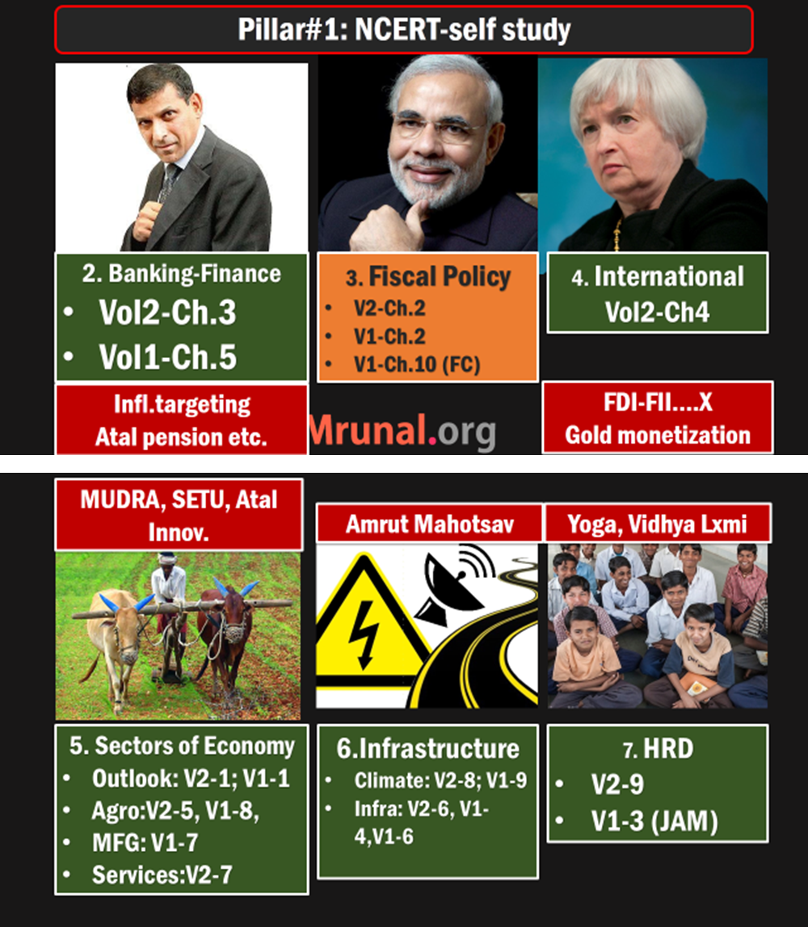

Slide 2
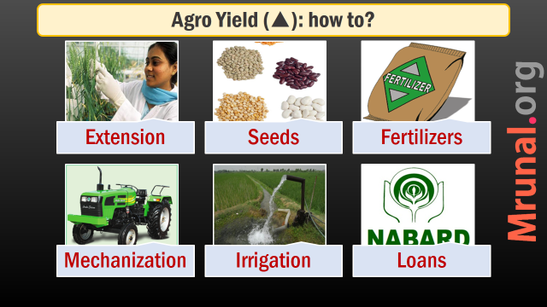
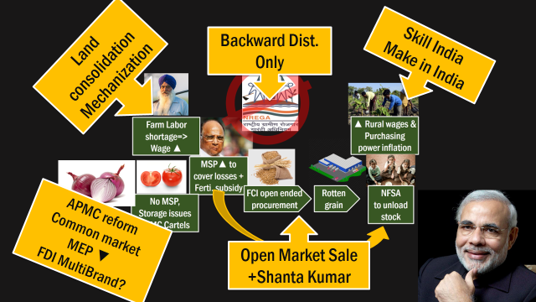
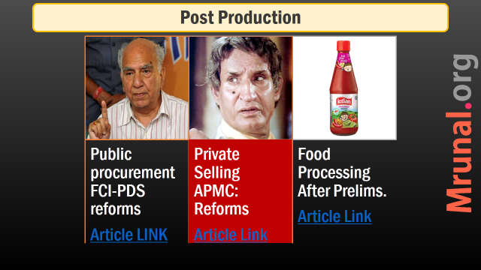

Slide 3
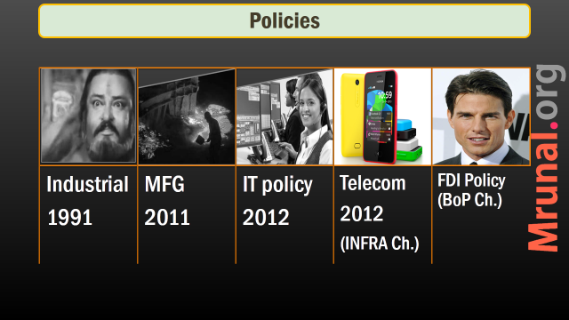
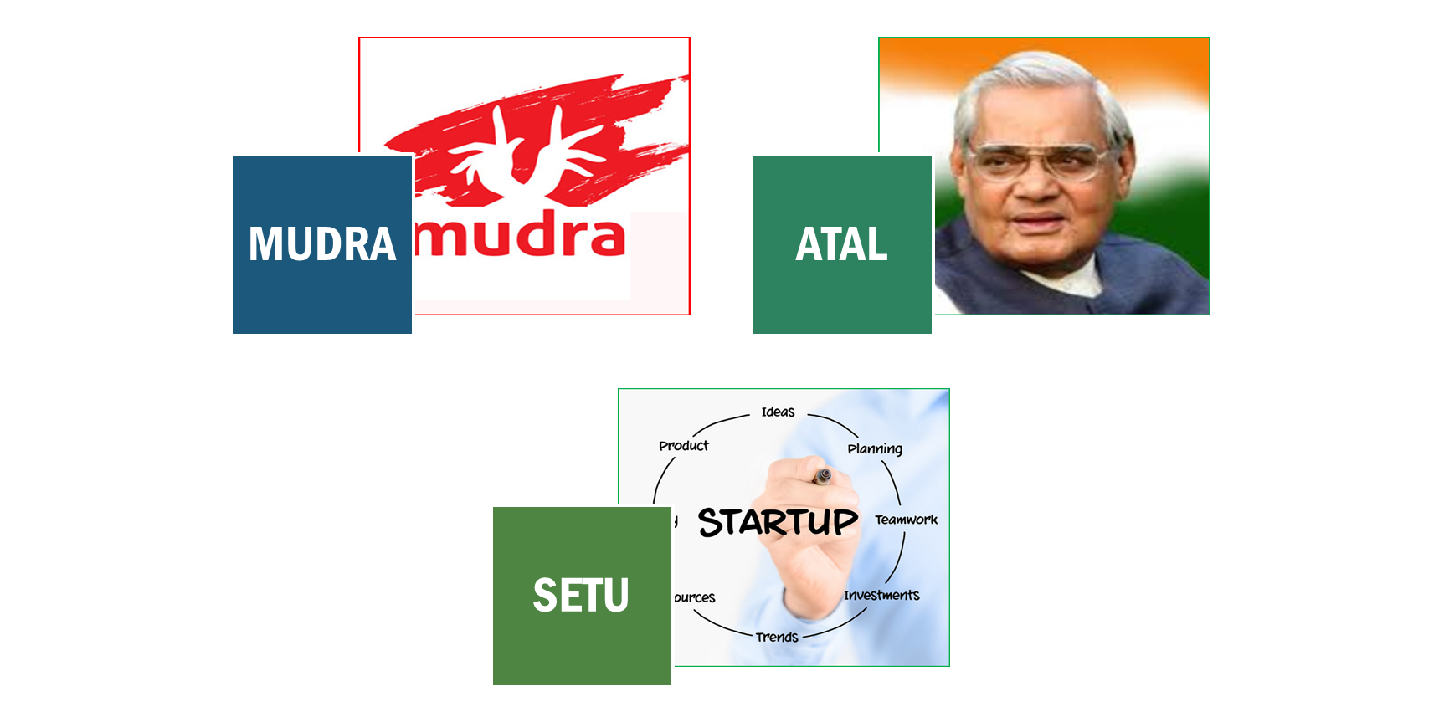
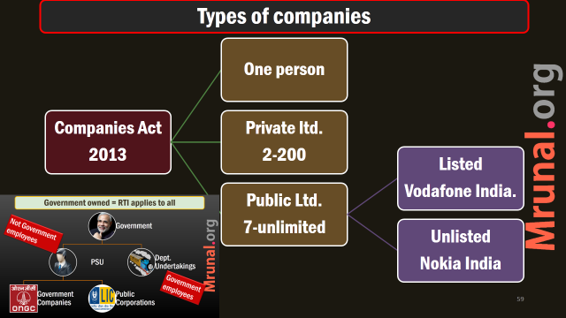
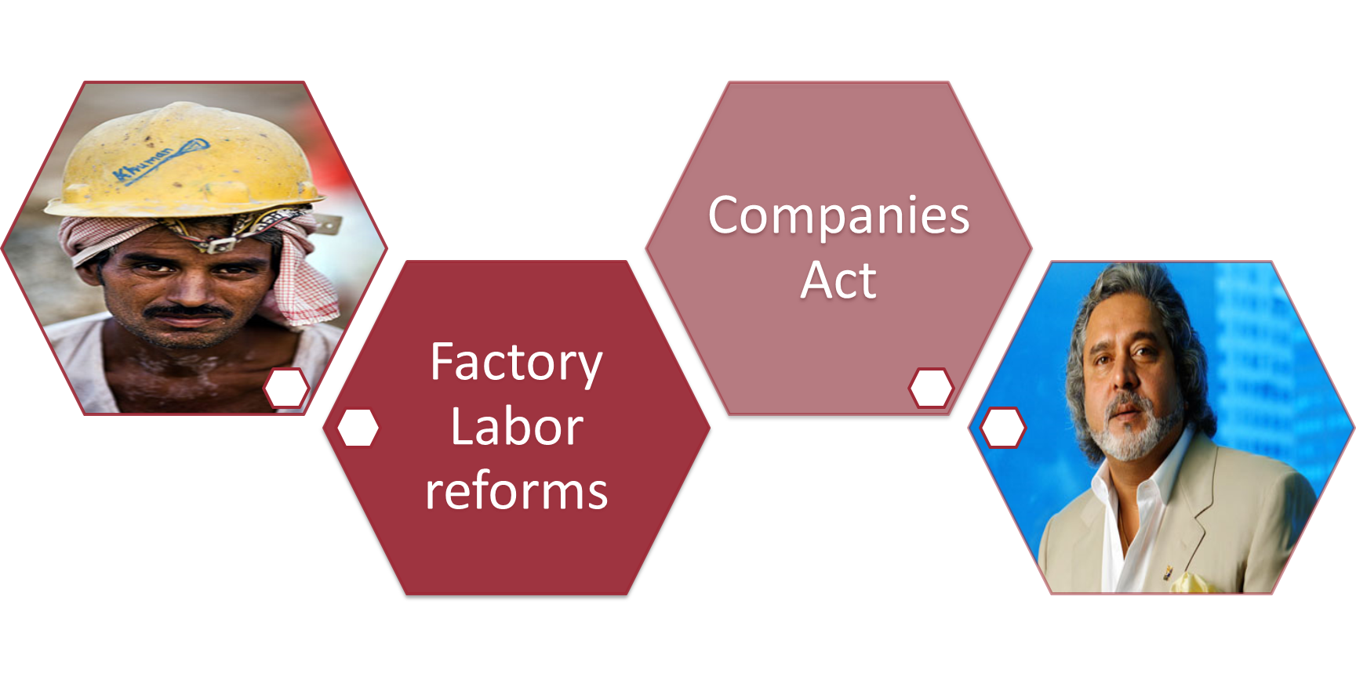


Slide 4





Why Skill People?
Disguised unemployment ▼
Make in India ▲
Reap demographic Div. ▲

Slide 5

Why?
Skilling
Disguised unemployment vs. demographic dividend
Land consolidation => bigger farm => mechanization => agro output ▲
~6 crore worker shortage in 1st world by 2020.
Only 10% of new India workers skilled. (China 50%)
Make in India useless without skilled workers.

Slide 6

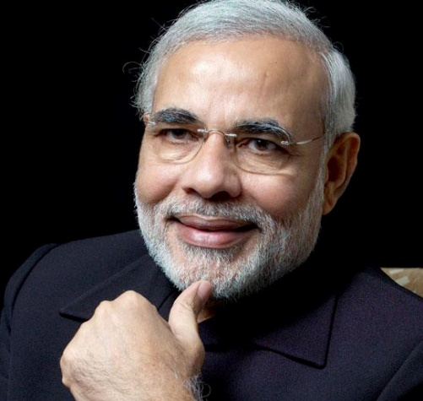
NSDC (UPA)
Skill Ministry (Modi)
National Skill Development Council (2009)
Ownership: 49% Finmin + 51% private
Skill 15cr Indians by 2022
Modi setup special Ministry for Skill and entrepreneurship

Slide 7
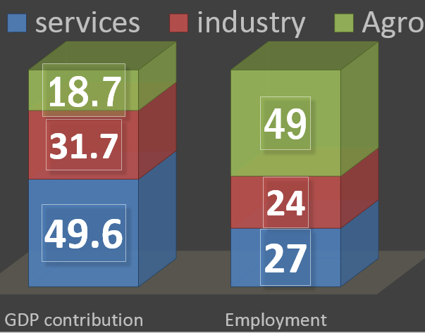
Skilling: HOW?
PMKVY
Din Dayal
Minorities
Skill India

Slide 8
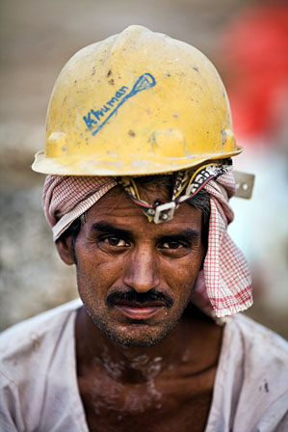
Skill India program
Budget 2014
national multi-skill programme
employability + entrepreneur skills
Traditional professions like welders, carpenters, cobblers, masons, blacksmiths, weavers etc
Budget 2015: National Skill Mission- to consolidate various programs

Slide 9

UDAN STAR
Existing
Udaan: J&K youth skill training program (MHA ,NSDC)
STAR: National Skill Certification and Monetary Rewards Scheme (NSDC) => PMKVY

Slide 10
PMKVY (Mar-21-2015)
NEW
Pradhan Mantri’s Kaushal Vikas Yojana
Replaces NSDC’s “STAR” scheme
Complete training => 8k + certificate. Need Aadhar + Bank account
>8k reward for mfg. courses
Eligible for loans 20k to 1.5L

Slide 11
PMKVY (Mar-21-2015)
NEW
Soft skill +computer courses
14 L Youth + 10 L Workers =24 lakh people covered
Focus on class10, 12 dropouts.
1,500 Crores allotted: 10% for NE.

Slide 12
Skilling: HOW?
PMKVY
Din Dayal
Minorities
Skill India

Slide 13
Din Dayal Antyodaya Yojana: Detailed Article Link
Greemin Kaushalya
Urban
Train 10 lakh in 3 years, PH attention, Intl.Syllabus
Train 5 lakh each year, setup SHG, Cheap Loans, Vendor Training
Ministry of Rural Development
Min. Housing & Urban Poverty Alleviation

Slide 14
Skilling: HOW?
PMKVY
Din Dayal
Minorities
Skill India

Slide 15

MINORITIES USTAAD
Budget 2014
“Up gradation of Traditional Skills in Arts, Resources and Goods
Kashmiri embroidery
Bengali Muslim: Jardosi embroidery
Sikh- Phulkari embroidery
Buddhist – Thangka painting

Slide 16
Nai Manzil
Budget 2015
Skill training Madrasa passouts with their mainstream counterparts.
They can get better employment without formal school leaving certificate
As such launched post-Budget 2014
But Money formally sanctioned in budget 2015 (~3k crores)

Slide 17

Skilling: problems: no common definition, still lot of overlapping among ministries
Why?
How?
DemDiv: 65% below 35%
Make in India
Shift away from Agro
Later
New AIIMS/IITs , Pension / Insurance social security
In HRD lecture
schooling, / ASER

Slide 19
Make in India
How?
Policy interventions
Why?

Slide 20
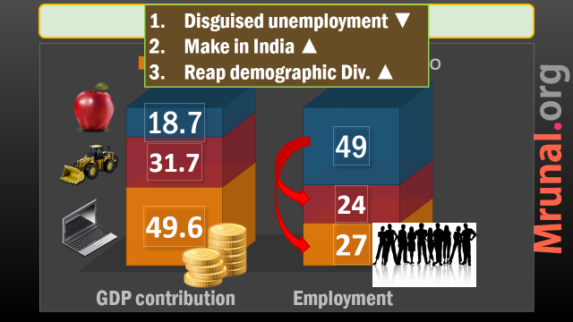
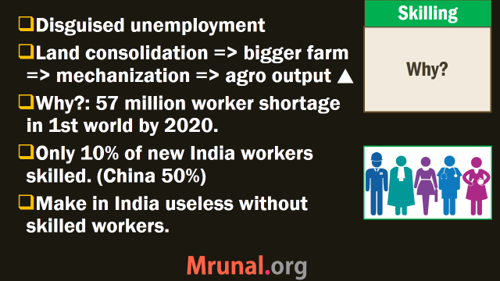
Why Make in India?: Ans. recycle points from why “Skill India”

Slide 21
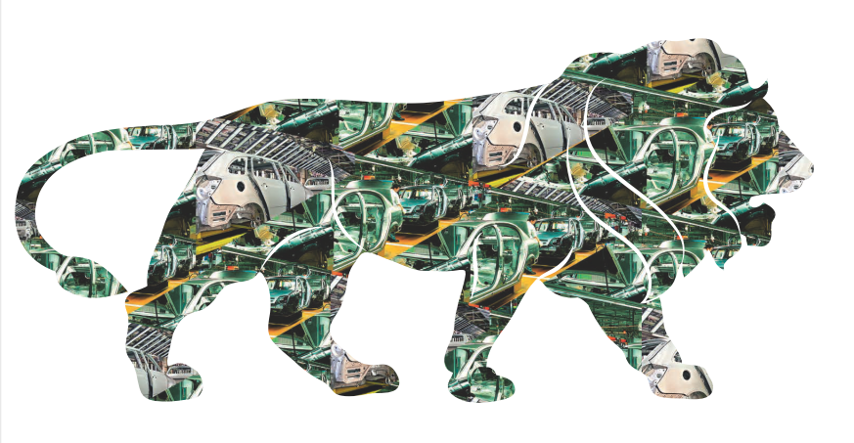

Make in India
WHY?
India became Agrarian => direct service economy. Not much focus on mfg. sector.
3D-Strength = democracy, demographic dividend, demand in huge quantity

Slide 22
Make in India
How? 5 pillars
Policy interventions
Why?

Slide 23
Make in India: “HOW” -5 Pillar Strategy
Simplify Processes
Focus 30 Sectors
Open New Sectors (FDI)
Infra. ▲
IPR protection

Slide 24

Make in India
Challenge?
But, World Economic Forum's Global Competitiveness Index: 71 (2014, September)
World Bank Ease Of Doing Business Rank: 142 out of 189 (2014, Oct). Target: 50th Rank by 2017.

Slide 25

Simplify Procedures
Make in India
industrial license valid for 3 years
New Factories bill, Shram Suvidha portal for self compliance
Companies Act 2013
eBiz portal to apply online
Special team to guide first time investor

Slide 26
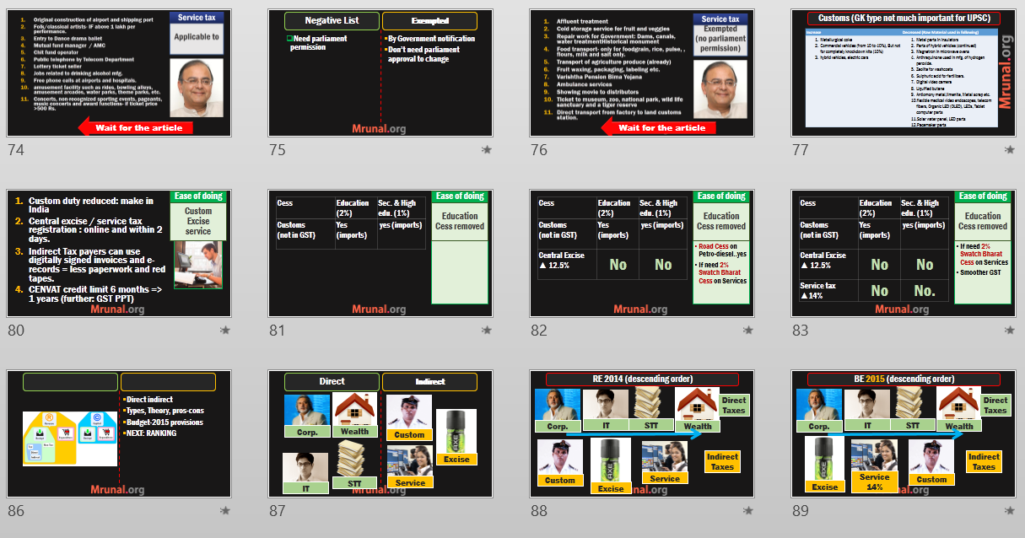
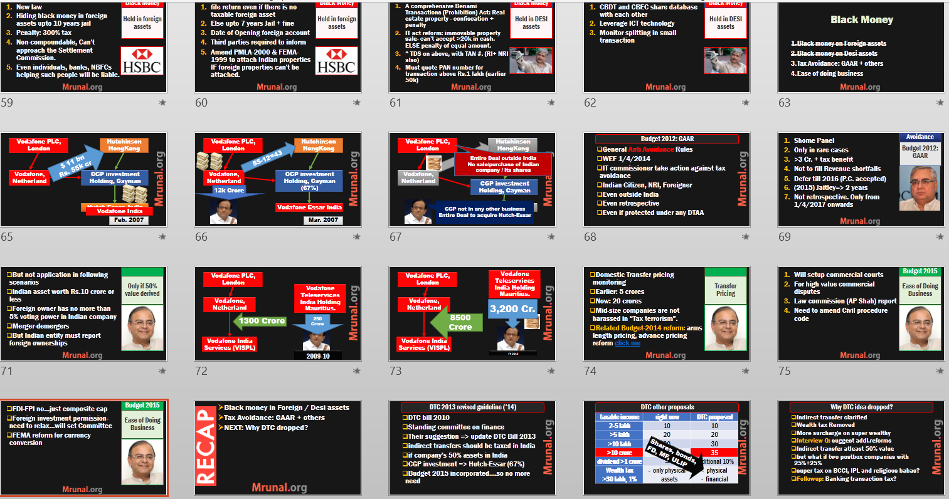
Budget 2015: Tax-clarity and ease of doing Biz.
Ref: L4/P1 PPT
Ref: L4/P2 PPT

Slide 27
Foreign Trade Policy 2015

Slide 28
Make in India: 5 Pillar Strategy
Simplify Processes
Focus 30 Sectors
Open New Sectors (FDI)
Infra. ▲
IPR protection

Slide 29

IPR protection
Make in India
Copyright =>HRD
Patent
Design & trademarks
GI

Slide 30
IPR Patent
Make in India
Patent: innovative product / process for industrial use
DIPP=>Patent office.
Indian patent offices to connect online under Madrid Protocol
Automated applications
Notes:
Policy and promotion

Slide 31
Design & Trademarks
Make in India
Industrial design registration for 10 years. Renewed again for 5 years.
trade marks: Automated registration, infinite renewal

Slide 32
Geographical Indicators
Make in India
A statutory GI registry body @Chennai
Foreign companies can register GI in India under WTO-TRIPS agreement

Slide 33
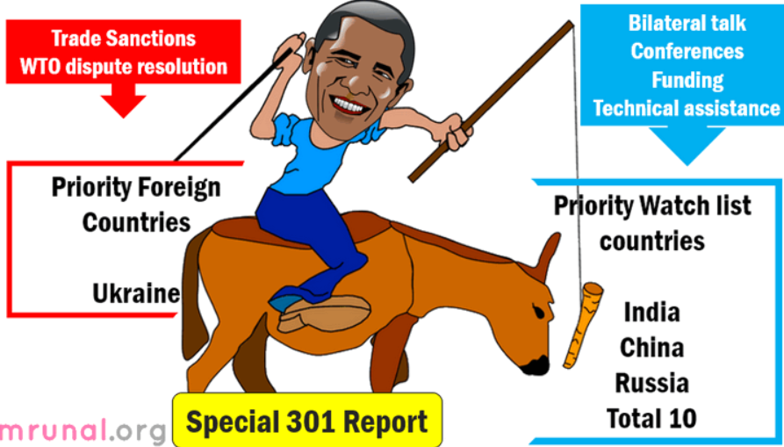
Follow up: special 301 report Article Link

Slide 34
Make in India: 5 Pillar Strategy
Simplify Processes
Focus 30 Sectors
Open New Sectors (FDI)
Infra. ▲
IPR protection

Slide 35
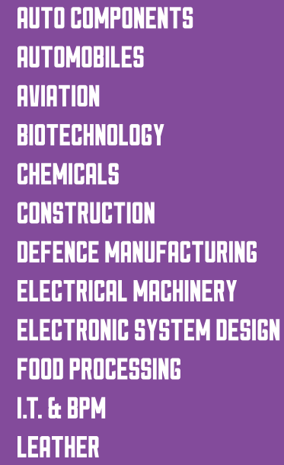

30 sectors
Make in India
Potential to become world top-10
Skilled men, resources, demand available

Slide 36
Make in India: 5 Pillar Strategy
Simplify Processes
Focus 30 Sectors
Open New Sectors (FDI)
Infra. ▲
IPR protection
Later in Relevant Survey Chapters.

Slide 37
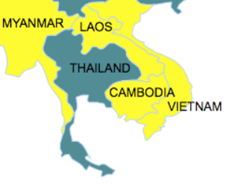
Make Outside India
Budget 2015
Under “Act East” Policy
Setup mfg. units in Cambodia, Myanmar, Laos, Vietnam. (CMLV)
Via special purpose vehicle (SPV)
Become part of “regional Value chain”
From CMLV, Export to countries having FTA with CMLV. (e.g. China)

Slide 38
Make in India
How? 5 pillars
3 Policy interventions
Why?

Slide 39
Make In India: Policy interventions required
Protectionism
Ease of Doing Biz.
Industrial Policy
▼Effectiveness
▲Controversy

Slide 40

Ease of Doing Biz
Policy
Reform tax, labor, land laws
E.g. Rajasthan: industrial dispute act only on units with 100 300 workers or more.
Linking MNREGA with skill / apprentice programs.
Connectivity and infrastructure
Promote investment FDI
Will benefit all sectors.
Highly effective, Least controversial

Slide 41
Make In India: Policy interventions required
Protectionism
Ease of Doing Biz.
Industrial Policy
▼Effectiveness
▲Controversy

Slide 42
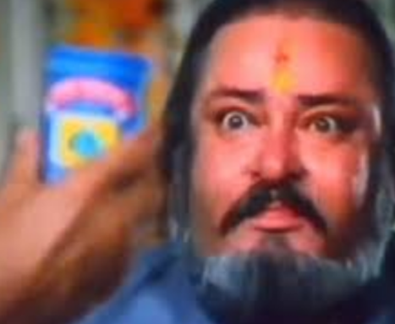
Industrial policy
policy
Give Subsidies, grants
Cheap loans
SEZ for mfg. industries
Controversial because
▲ Fiscal deficit
SEZ: land acquisition
Non tariff barrier: WTO disputes

Slide 43
Make In India: Policy interventions required
Protectionism
Ease of Doing Biz.
Industrial Policy
▼Effectiveness
▲Controversy

Slide 44

Protectionism
Policy
Tariff barrier on foreign goods.
“domestic requirement” in public procurement
Controversial because
WTO, Trade agreements violated
Indian exporters will get similar treatment elsewhere
Smuggling, parallel economy

Slide 45
Make In India: Policy interventions required
Protectionism
Ease of Doing Biz.
Industrial Policy
▼Effectiveness
▲Controversy

Slide 46
Mains / Interview
“In a globally integrated economy, Indian Government has limited policy maneuvers to promote Make in India.” Discuss.
3 layered pyramid
Tariff barriers (high taxes) x WTO
Non-Tarrif Barriers (subsidies) x WTO | Fiscal deficit.
More: TPP, RCEP, Foreign Trade policy 2015

Slide 47
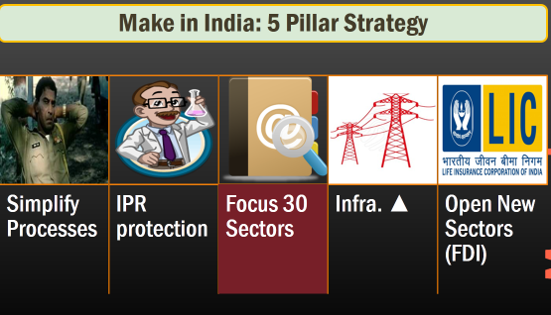
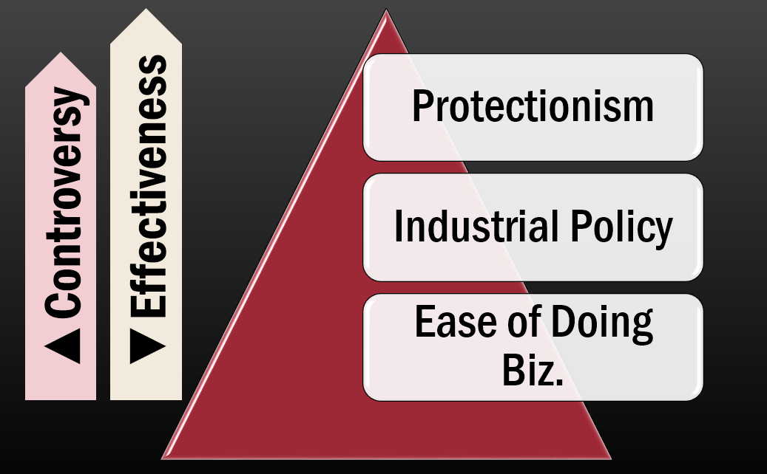

Slide 48
Survey: Making, Skilling, Mfg, Services
Make in India
Skill India
Why and How
Why and How
5 pillars
Skill India x 3 areas
Policy intervention

Slide 49
Mains / Interview Q. from survey
Since the industrial revolution, no country has become a major economy without becoming an industrial power. Examine the importance of “Make in India” in this regard. (Lee Kuan Yew)
“The future trajectory of Indian economic development depends on both Make in India and Skill India.” Elaborate
Inclusive growth necessitates greater focus on manufacturing than service sector. Do you agree?

Slide 50
3 ways to boost GDP (survey Vol1.Ch7)
Geology
Geography
Jeans

Slide 51
3 ways to boost GDP (survey Vol1.Ch7)
Geology
W.Asia
Geography
Barbados
Jeans
Low Skills mfg.
Botswana
Chile
Australia
Canada
Mauritius
Caribbean
China
Thailand
Indonesia
Malaysia
Tourism
Energy & Minerals

Slide 52

India’s Jeans Conundrum
GDP ▲
Geology: Shale Gas technology bottlenecks. Coal mining scam.
Geography: Tourism potential yes, but alone insufficient to sustain a large nation.
Jeans: Low skilled mfg. Most East Asian economies grew with this. India has abundant low skill manpower= natural advantage.

Slide 53
Direct jump to high-end, high-skill mfg =Problem
Agrarian
Jeans
Jets
Low skill mfg.
High-Skill
Our natural advantage here
Jeans-XP = Jets
But “Make in India” direct focus on such “high-end” mfg.
Jump difficult.
Notes:
Abundant unskilled cheap Labour….yes our Natural advantage.
Export Demand….yes
Later, the “experience” helps in high-end mfg & electronic goods- S.Korea, China et al.
But Make in India-direct jump to #3….difficult

Slide 54
30 sectors
Make in India
Skilled men?
Inclusive growth?

Slide 55
Export Demand
GDP ▲
Rapid growth comes from domestic market….never in history
Rapid growth comes from export of mfg. goods (not services)
Other nations can’t absorb all our imports, given FTA/Trade agreements among giants (make OUTSIDE India)
Construction…not “tradable / exportable”

Slide 56
Focus? Service vs manufacturing?
Manufacturing
Services
Not inclusive
Registered mfg. = 7x more productive than unregistered
But require skilled workers
Need highly skilled men
If all Labour capital employed we’ll be richer than S.Korea

Slide 57

Reg.MFG not inclusive
Mfg. sector
Gujarat: 20% GSDP from registered mfg. units- Closer to growth model of East Asian economies.
But this model not ‘inclusive’. Gujarat only 5% employed in Reg.MFG units (diploma minimum)
+ poorer states must growth @faster rate, else regional imbalance, Naxal issues.

Slide 58
So far
Geography, Geology, Jeans
Service vs. mfg = Reg.mfg
Red.MFG= skill India
Notes:
Service sector - skill intensive- not aligned with India’s comparative advantage (unskilled workers).
Services can give growth but not “inclusive growth”
Registered mfg. units= way to go. But rapid skill up gradation needed.

Slide 59
India’s “premature De non-industrialization”
Agrarian
Jeans
Service Giant
Low skill mfg.
Outsourcing to Jeans economies
Our natural advantage here
Large capital invested here
2 digit growth rate = yes
Inclusive growth = no
Notes:
Agrarian => Jeans Economy => industrialization
Service sector growth, outsourcing to cheaper “Jeans” nations.
While Your country becomes a financial hub, MNC-HQ.
De-industrialization begins.
India direct jump from agro to service- Ours is “pre-mature non-industrialization”

Slide 60
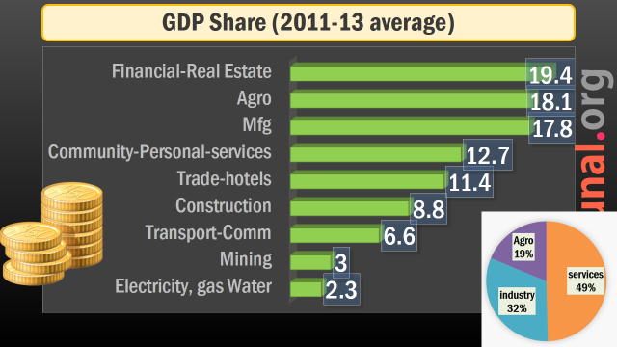
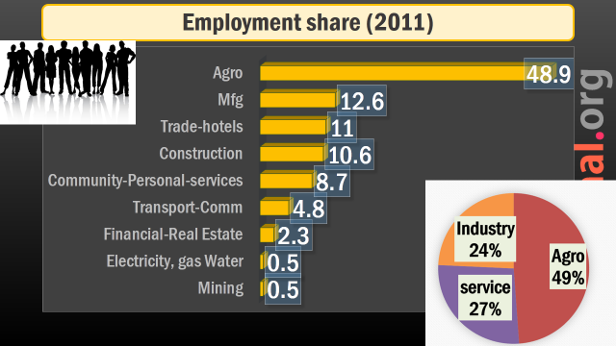

Slide 61
Mains / Interview
“Make in India is a flawed Idea.” Do you agree?
Re.Mfg = high skill, not our natural advantage.
Export capture difficult.
Premature non-industrialization
Difficult to absorb capital, workforce for inclusive growth
Rajan: not necessary Chinese mfg-story will replicate everywhere.

Slide 62
Skilling: Challenges
50-90s
Poor return on Education
Mid-2005
English Medium Boom
2020
Will enter in workforce
Low Skilled Generation
Till then have to make do with this generation
By “rehabilitating” thru skill India
Notes:
50s-90s, private return on “Education” was poor.
Recent years, service sector boom => English-medium private school boom
But, These Kids will enter workforce after 15-20 years
Have to ‘rehabilitate’ unskilled workforce generation in the meantime.

Slide 63
Mains / Interview
“The future trajectory of Indian economic development depends on both Make in India and Skill India.” Elaborate
Jeans economy, export demand= GDP boost
Registered mfg. units need skilled workforce.
poor return on education till mid-2000s.

Slide 64
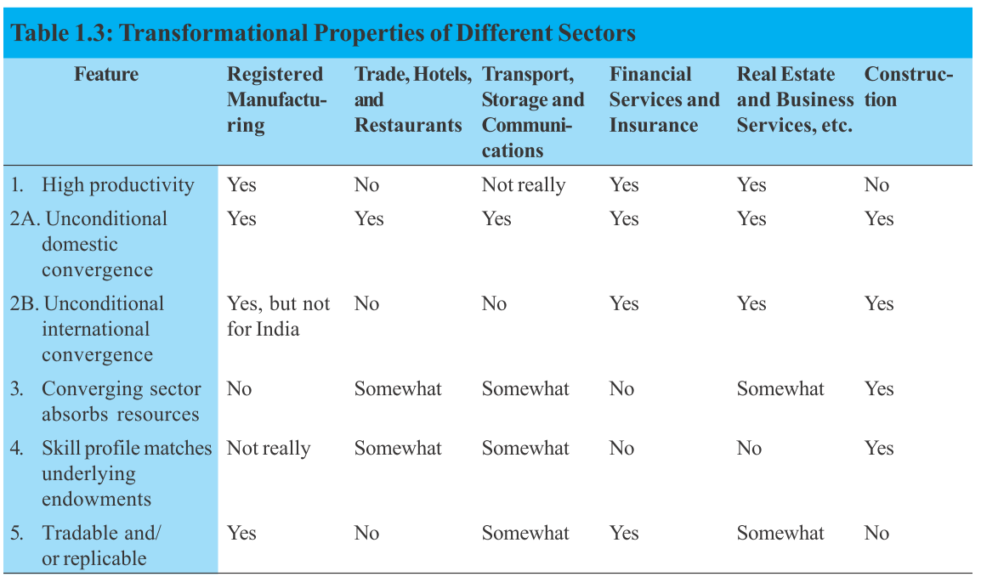
Sectors that can transform India

Slide 66



Slide 67


Slide 68
Service sector
Rankings
Tourism
E-Commerce / Retail
IT/ICT
Entertainment

Slide 69

India: service high in GDP but low in employment
services
Overall GDP
USA
Service GDP
USA
China
India 10th
China
Japan
Japan
India 11th

Slide 70
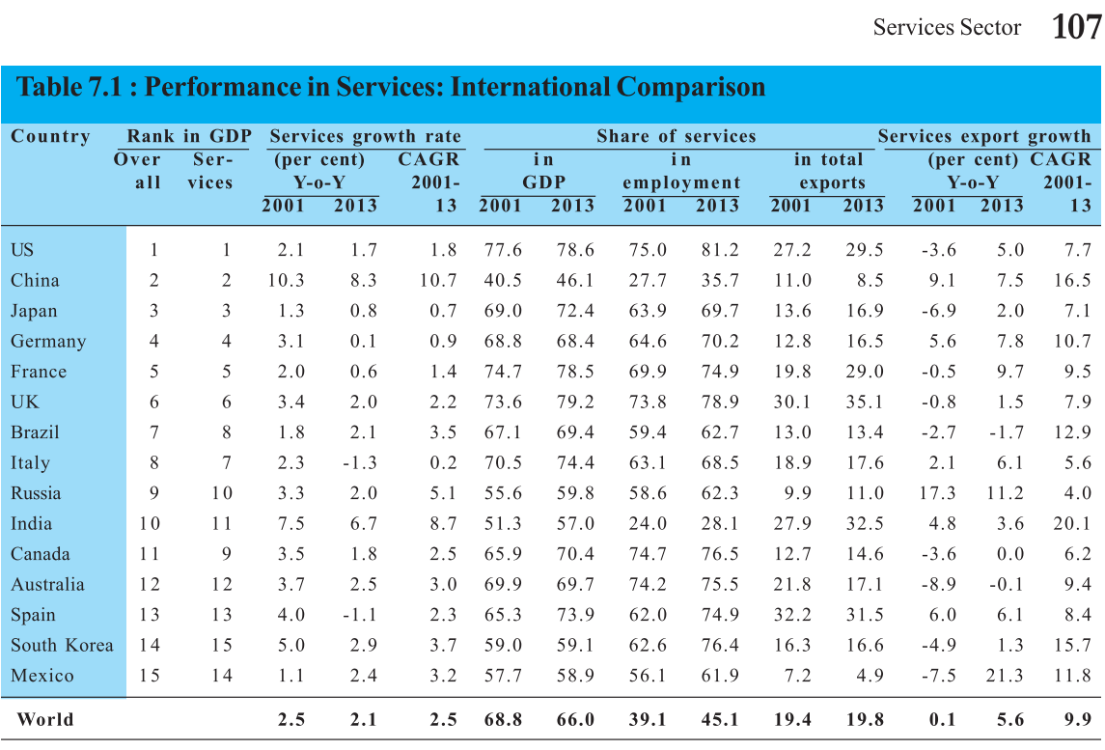
India #1 in service exports

Slide 71
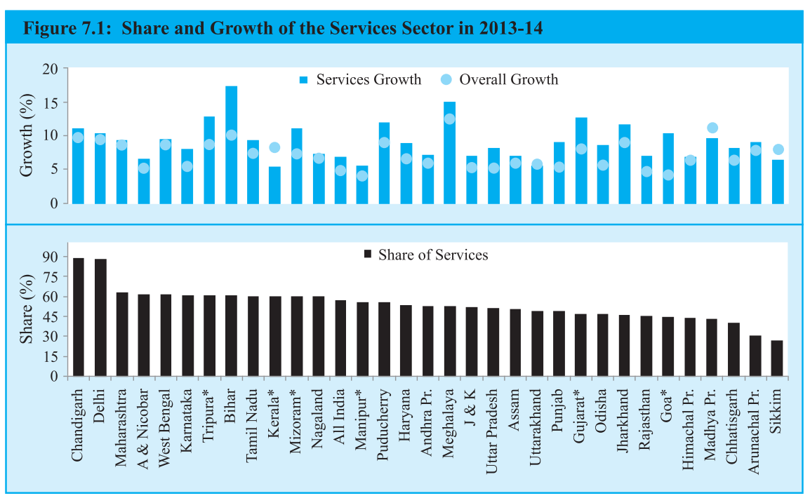
Services share in GSDP of the states

Slide 72
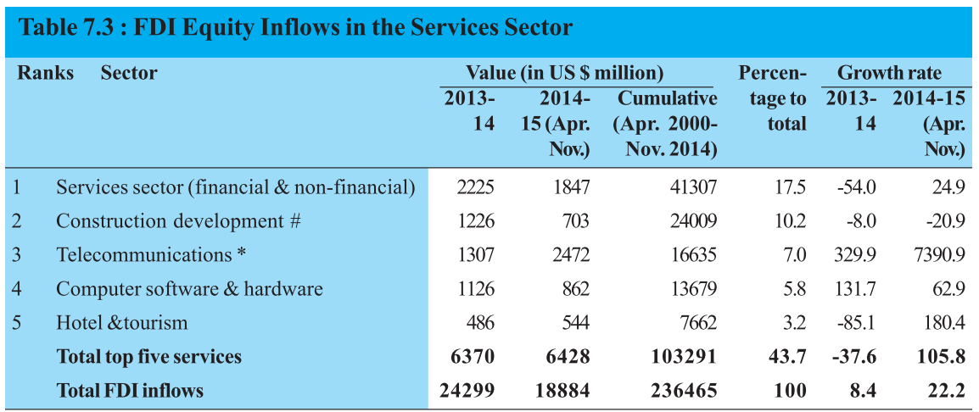
Highest FDI inflows in Service sector

Slide 73

Tourism
Services
World GDP: 7 trillion USD, Total 250+ million jobs. Every 1/ 11 jobs.
Within India: 5% direct, 7% indirect jobs due to Tourism.
Buddhist circuit
Ganga cleaning
Visa on Arrival and E-visa.

Slide 74
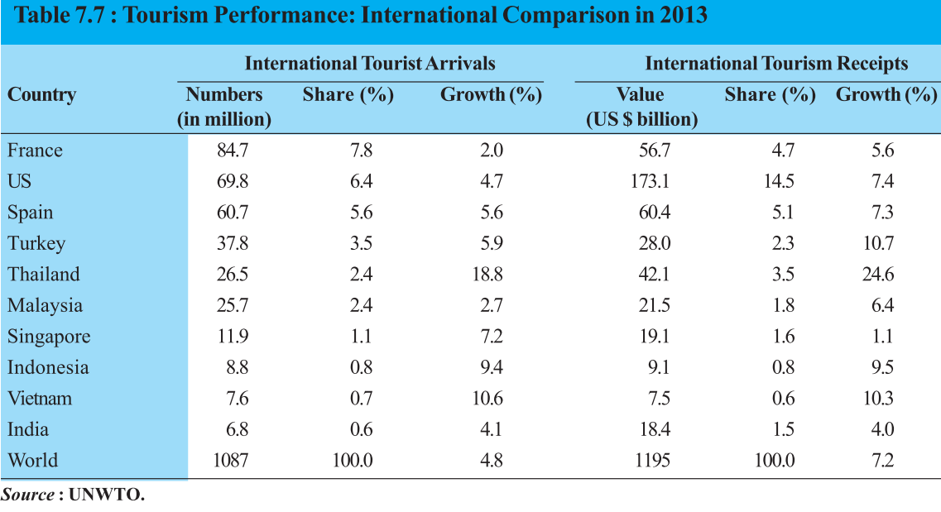
Tourist destinations

Slide 75

IT/Comm.
Services
Single largest contributor
35 lakh employed
Global Competitiveness Index 2014: India sucks on most parameter, compared to 1st world and even among BRICS
Internet penetration low.
More: Foreign trade policy lecture

Slide 76
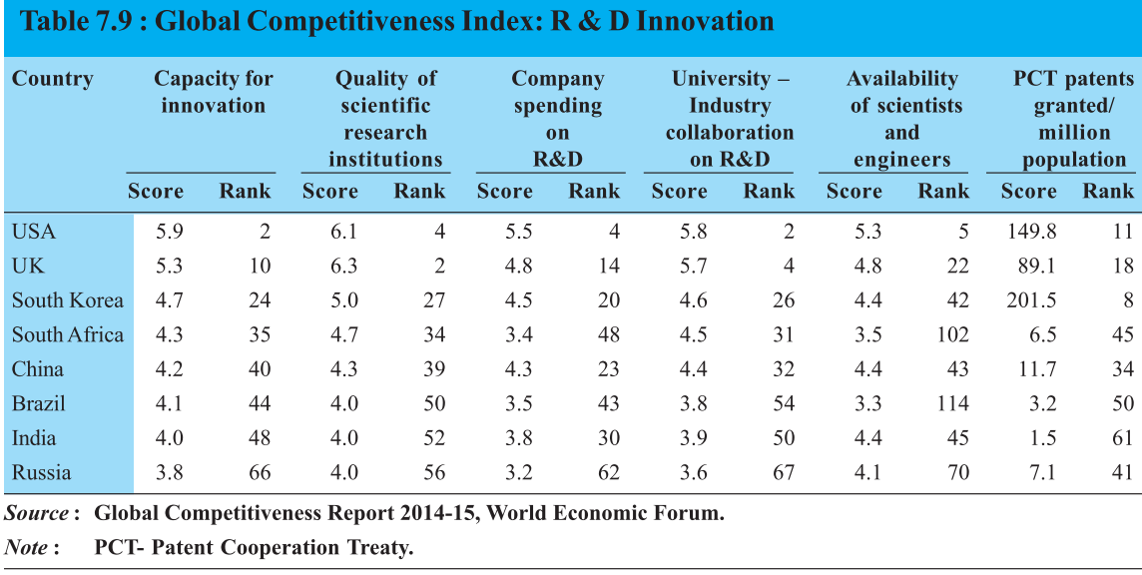

Innovation and India

Slide 77
Service sector
Rankings
Tourism
E-Commerce / Retail
IT/ICT
Entertainment

Slide 78

Retail trade
Services
65% population below 35%
Urban nuclear families, Disposable income
E-commerce to grow by 50% in 5 years
Consumer protection act 1986 needs update.
FDI multi-brand retail- 51% with Government approval but many caveats. (Budget, Survey silent tho.)

Slide 79

Entertainment
Services
Largest # of TVs: US, China, India (16 crore)
Television, print, animation, VFX etc. billion dollar industry
Digitization of cable TV: 4 phases, by 31/12/2016
Result: better service, better revenue

Slide 80
Entertainment
Services
News Broadcast: 26% FDI
DTH: 74%
Films: 100%
Disney, Fox, Sony, Warner co-producing movies with Indian companies.

Slide 81
Entertainment
Services

Slide 82
Pending services: in Infrastructure lecture
Shipping
Telecom
Railways
Real Estate Housing

Slide 83
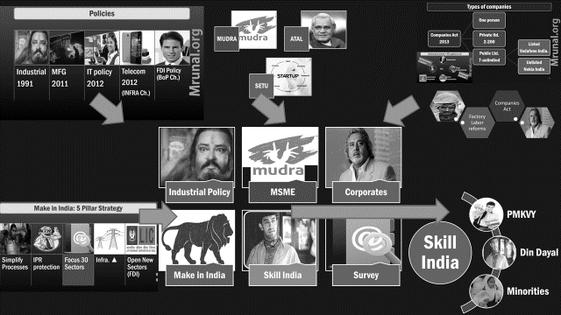
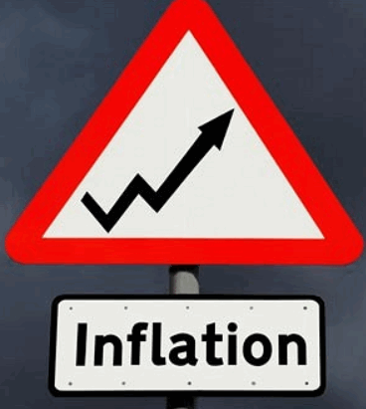
Disinvestment, infra.
Future Lectures
And chapters
Insurance, FDI-FII
HRD, Social security
NEXT

